Slide 1

Presentation on “Sugarcane Crop Support System”
SAPTHAGIRI COLLEGE OF ENGINEERING
(Affiliated to Visvesvaraya Technological University, Belagavi & Approved by AICTE, New Delhi.)
Department of Computer Science & Engineering
Presented By:
Under the Guidance of :
Prof. Anuradha B
Assistant Professor,
Dept. of CSE
ASHWIN RAMESH P | 1SG16CS016
BINDHU M V | 1SG16CS020
DIVIJ N | 1SG16CS029
DIVYA K | 1SG16CS030

Slide 2
INTRODUCTION
Sugarcane is the world's largest crop by production quantity, with 1.9 billion tonnes produced in 2016.
It is cultivated on about 26 million hectares.
Pests, insects, pathogens infect the plants resulting in decrease in the production to large scale if not controlled within time.
The proposed system mainly deals with Detection and Prevention of sugarcane diseases.

Slide 3
LITERATURE SURVEY
Title 1 | Author and published year | Methodology | Limitations
Early Detection of Grapes Diseases Using Machine Learning and IoT | SUYASH S. PATIL, SANDEEP A. THORAT. (CCIP) 2016 | Using Statistical and Hidden Markov Model to detect diseased grape plants. Using of Sensor Networks and WiFi modules for transmission of data. | Huge implementation cost. Requires active connection to cloud from sensors and requires users to have active net connection.

Slide 4
LITERATURE SURVEY
Title 2 | Author and published year | Methodology | Limitations
Novel Machine Learning Based Approach For Detection And Classification Of Sugarcane Plant Disease By Using DWT | B SRAVYA REDDY, R DEEPA, S SHALINI, P BHAGYA DIVYA (IRJET Vol.4) 2017 | Detection of disease is done using discrete wave length transform algorithm and decision tree approach to classify the disease. Infected plant images are stored in the database and are compared with the input image. | Specific only for leaves. A high end camera is required to capture images. Only certain diseases are addressed.

Slide 5
LITERATURE SURVEY
Title 3 | Author and published year | Methodology | Limitations
Detecting Sugarcane Borer Diseases Using Support Vector Machine | TISEN HUANG , RUI YANG, WENSHAN HUANG , YIQI HUANG , XI QIAO. (CHINESE UNIVERSITY OF HONG-KONG, ELSEVIER) 2017 | Sugarcane borer disease is detected using greyscale conversion for image processing , and SVM algorithm for classification. | SVM is applicable only for linear dataset The proposed system is confined to only detect stem related disease.

Slide 6
LITERATURE SURVEY
Title 4 | Author and published year | Methodology | Limitations
Sugarcane Disease Detection Using Data Mining Techniques | S SATHIAMOORTHY, R PONNUSAMY, M NATARAJAN. (IJRAT E-ISSN: 2321-9637) 2018 | R Datasets are used for experimental studies . Techniques like k means , MLP are used to predict sugarcane leaf disease . | R Dataset considers only limited attributes and thus cannot be generalized. The proposed system addresses detection of “coal of sugarcane disease”.

Slide 7
LITERATURE SURVEY
Title 5 | Author and published year | Methodology | Limitations
Paddy Disease Detection System using Image Processing | RADHIAH BINTI ZAINON 2012 | Binary image of the paddy leaves is used to identify the diseased plant. | A binary image is a digital image that has only to possible values for each pixel, typically black and white.

Slide 8
LITERATURE SURVEY
Title 6 | Author and published year | Methodology | Limitations
Leaf Disease Detection Using Image Processing | SUJATHA R, Y SRAVAN KUMAR AND GARINE UMA AKHIL . (JCHPS Vol.10) 2017 | Converting RGB to HSI (Hue, Saturation, Intensity) image. SVM and k-means clustering has been used in this System. | HSI separates the intensity (luma) from color information (chroma).

Slide 9
LITERATURE SURVEY
Title 7 | Author and published year | Methodology | Limitations
Plant Disease Detection Using Different Algorithms | TRIMI NEHA TETE, SUSHMA KAMLU (RICE Vol.10) 2017 | Two different segmentation techniques: Thresholding and K-means clustering algorithm and classification technique such as Artificial neural network (feed forward back propagation). | Thresholding cannot be applied on images with low variation. Difficult to predict the k value manually.

Slide 10
LITERATURE SURVEY
Title 8 | Author and published year | Methodology | Limitations
An Algorithm for Plant Diseases Detection Based on Color Features | MOSBAH EL SGHAIR, RAKA JOVANOVIC, MILAN TUBA (IJAS Vol.2) 2017 | Four different color models were tested and compared: RGB, YCbCr, HSI color model. Median filter is employed for image smoothing (Noise reduction). Kapur’s thresholding for plant diseases detection was proposed. | Emphasis only on image pre-processing Disturbance due to vein is present in RGB models. Calculative dimensions of disease spot is not considered.

Slide 11
LITERATURE SURVEY
Title 9 | Author and published year | Methodology | Limitations
Real-time Hevea Leaves Diseases Identification using Sobel Edge Algorithm on FPGA: A Preliminary Study. | NORFARAHIN MOHD YUSOFF, ILI SHAIRAH ABDUL HALIM, NOOR EZAN ABDULLAH, A’ZRAA AFHZAN AB. RAHIM. (ICSGRC) 2018 | Sobel Edge Algorithm is used. Images of 1280*960 pixels are used. Used for detection of Leaf diseases in Hevea plant. | Used for detection of leaf disease. Requires fixed ratio of image.

Slide 12
LITERATURE SURVEY
Title 10 | Author and published year | Methodology | Limitations
An Investigation Into Machine Learning Regression Techniques for the Leaf Rust Disease Detection Using Hyperspectral Measurement | DAVOUD ASHOURLOO, HOSSEIN AGHIGHI, ALI AKBAR MATKAN, MOHAMMAD REZA MOBASHERI, AND AMIR MOEINI RAD. (IEEE) 2016 | Spectral data of leaf is used ASD-Spectroradiometer is used. Another set of photos were taken in RGB and converted to HSI GPR algorithm is used. | Requires expert assistance. Requires spectrodiameter and canon camera.

Slide 13
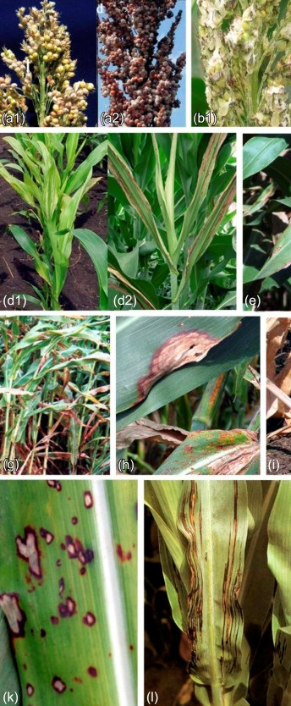
PROBLEM STATEMENT
To design and develop a system for detection and prevention of major sugarcane diseases.

Slide 14
THANK YOU

